Slide 1


Andrew Doublard
06-05-2024

Slide 2

Outline
Executive Summary
Introduction
Methodology
Results
Conclusion
Appendix

Slide 3
Executive Summary
In this project the following methodologies were used:
Data Collection through API.
Data Collection with Web Scraping.
Data Wrangling.
Exploratory Data Analysis with SQL.
Exploratory Data Analysis with Data Visualization.
Interactive Visual Analytics with Folium.
Machine Learning Prediction.
Results:
Exploratory Data Analysis to identify key relationships.
Interactive Visual Analytics to show the outcomes.
Predictive Analytics to answer the business question.

Slide 4
Introduction
Space travel is beginning to become a reality due to companies like SpaceX making it more affordable. SpaceX achieves this via their reusable Falcon 9 rockets which reduces costs to $62m, roughly one third of it’s competitors. In this project, I will analyse SpaceX's data using machine learning, with the goal of predicting whether the Falcon 9 first stage will land and in turn, also predicting its cost.
Main Objectives:
Identify the key relationships which determine if the rocket will land successfully.
How these key relationships interact to give the success rate of a particular set of conditions.
Which conditions yield the highest chance of a successful outcome.

Slide 5

Section 1

Slide 6
Methodology
Executive Summary
Data collection methodology:
Requesting data from SpaceX’s API.
Web scraping from SpaceX’s Wikipedia.
Perform data wrangling
Adding a Landing Outcome label.
Perform exploratory data analysis (EDA) using visualization and SQL
Perform interactive visual analytics using Folium and Plotly Dash
Perform predictive analysis using classification models
How to build, tune, evaluate classification models

Slide 7
Data Collection
Part 1 of the Data Collection was to make a request to the SpaceX API:
Requested and parsed the SpaceX launch data using the GET request.
Used json_normalize method to convert the Json result into a data frame.
Filtered the data frame to only include Falcon 9 launches.
Dealt with missing values, replacing the missing Payload Mass with the mean value.
Part 2 was to use web scraping on the SpaceX Wikipedia:
Request the Falcon9 Launch Wiki page from its URL.
Extract all column/variable names from the HTML table header.
Create a data frame by parsing the launch HTML tables.

Slide 8
Data Collection – SpaceX API
API Calls
Rocket Data, Launch Data, Payload Data, Landing Data.
Data Frame
Converting JSON result to Data Frame, and filtering to Falcon 9 Rockets only.
Data Wrangling
Replacing missing values for Payload with the mean.
I used the get request to the SpaceX API to collect data, clean the requested data and did some basic data wrangling and formatting.
GitHub documentation of this stage can be found here.

Slide 9
Data Collection - Scraping
Requesting Data from its URL
HTTP GET method to request the Falcon9 Launch HTML page, as an HTTP response. Then into a BeautifulSoup object.
Extracting Table and Columns
Using the find_all() function.
Creating Data Frame
Parsing the HTML tables. Appending the data into a empty dictionary that gets converted into a pandas data frame.
Web scraping from Falcon9 Launch Wikipedia page.
GitHub documentation of this stage can be found here.

Slide 10
Data Wrangling
Value_Counts()
Exploring the number of Launches per Site and Orbit.
Assigning Landing Variables
Creating lists for all landing outcomes and unsuccessful outcomes.
Adding ‘Class’ Column
Using the Landing variables to add a ‘Class’ column to determine if a landing was successful or not.
Wrangling the Data to create training labels.
GitHub documentation of this stage can be found here.

Slide 11
EDA with Data Visualization
1) Explored how flight number and payload relate to launch sites using scatter plots.
2) Visualized the success rates of different orbit types using a barplot.
3) Investigated the relationship between flight number and orbit type using a scatter point chart.
4) Explored the relationship between payload and orbit type using a scatter point chart.
5) Plotted the yearly trend of launch success to understand the program's performance over time.
6) Dummy Variables Creation:
Converted categorical columns into dummy variables for further analysis.
GitHub documentation of this stage can be found here.

Slide 12
EDA with SQL
A query to identify unique site used for launch by SpaceX.
Showed five records from launch sites with names containing string “CCA”.
Displayed total payload mass carried by boosters launched by NASA (CRS).
Showed the mean payload mass carried by booster version F9 v1.1.
Listed the date when the first successful landing outcome in ground pad was achieved.
List the names of the boosters which have success in drone ship and have payload mass greater than 4000 but less than 6000.
List the total number of successful and failure mission outcomes.
Used a subquery to list the names of the Booster versions which have carried the maximum payload mass.
Used Substr() to List the records which will display the month names, failure landing outcomes in drone ship, booster versions, launch site for the months in year 2015.
Rank the count of landing outcomes such as Failure (drone ship) or Success (ground pad) between the date 2010-06-04 and 2017-03-20, in descending order.
GitHub documentation of this stage can be found here.

Slide 13
Build an Interactive Map with Folium
Added map objects such as markers and circles of the launch sites on the folium map.
Added additional markers to each launch site to specify:
a) Successful launches with green markers.
b) Unsuccessful launches with red markers.
Put a marker on nearest coastline, and calculated distance to a launch site.
Drew a Polyline between the coastline and the launch site.
Put markers on, and then calculated distances to the closest city.
GitHub documentation of this stage can be found here.

Slide 14
Build a Dashboard with Plotly Dash
1) Displayed the total launches from each site using pie charts, providing an overview of launch distribution.
2) Plotted scatter graphs showing the relationship between outcomes and payload mass for different booster versions, offering insights into mission success relative to payload mass.
3) Integrated a dropdown menu to select launch sites and a range slider to choose payload masses, enhancing user interactivity and data exploration.
4) Implemented callback functions to allow real-time data visualization based on user input.
GitHub documentation of this stage can be found here.

Slide 15
Predictive Analysis (Classification)
Created a Numpy array from "Class“ variable.
Used StandardScaler to standardize the data.
Split into an 80:20 Train-Test set.
Identified best parameters
Assessed them accuracy using test data
Plotted Confusion Matrix
Approaches:
Logistic Regression
Support Vector Machine
Decision Tree Classifier
K-Nearest Neighbour
GitHub documentation of this stage can be found here.

Slide 16
Results
Exploratory data analysis results
Interactive analytics demo in screenshots
Predictive analysis results

Slide 17

Section 2

Slide 18
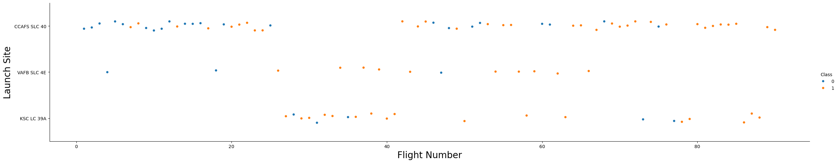
Flight Number vs. Launch Site
Flight success becomes more frequent as the number of flights increase.
Launch site CCAF SLC 40 is the most used launch site.

Slide 19
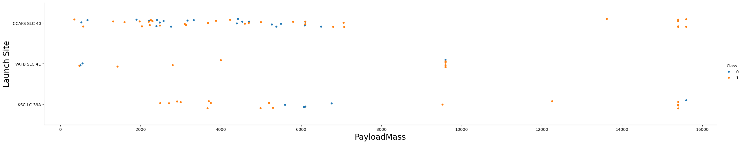
Payload vs. Launch Site
1) Greater payload masses yield more frequent successful landings.

Slide 20
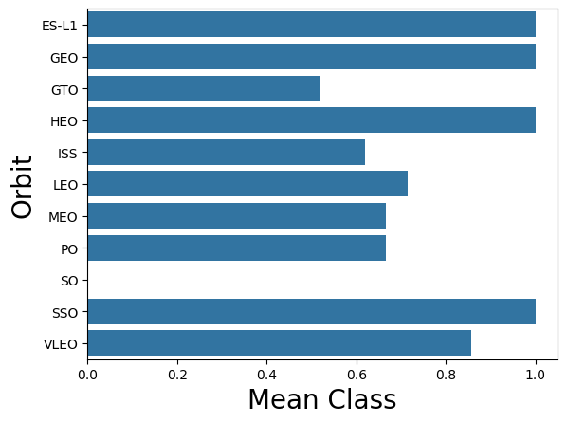
Success Rate vs. Orbit Type
1) Launches to orbits ES-L1, GEO, HEO, and SSO have the most successful landing outcomes with the mean class = 1 each, showing all landings were successful at these orbit types.

Slide 21
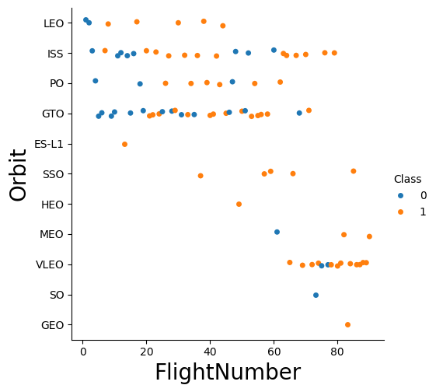
Flight Number vs. Orbit Type
1) Flights to orbit VLEO became more frequent with flight number, and were also more successful. Additionally, LEO orbit flights had a high success rate.

Slide 22
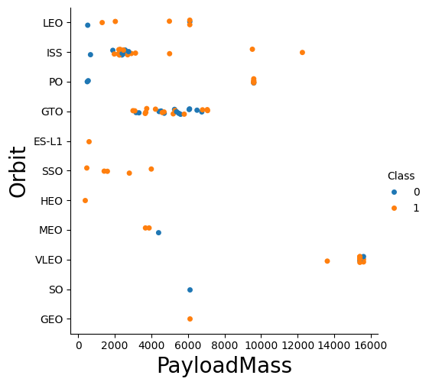
Payload vs. Orbit Type
1) Heavier payloads were more frequent at VLEO orbit. Orbits PO and ISS also had some heavier payloads. Heavier payloads also had more success.

Slide 23
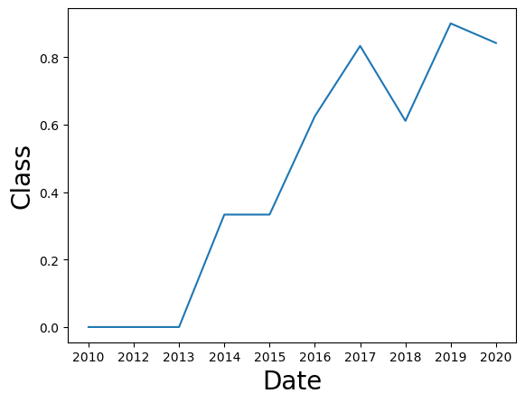
Launch Success Yearly Trend
1) Launch success improved as the years passed, with a dip in 2018 before peaking in 2019.

Slide 24
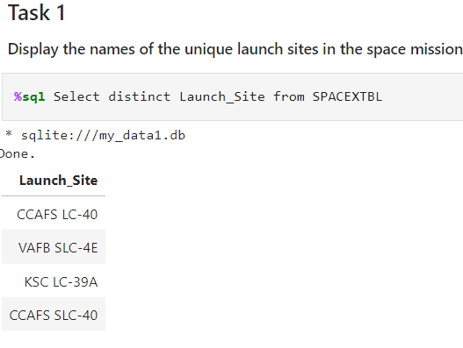
All Launch Site Names
1) SpaceX have used 4 launch sites, query was executed using ‘distinct’ to return unique cases.

Slide 25
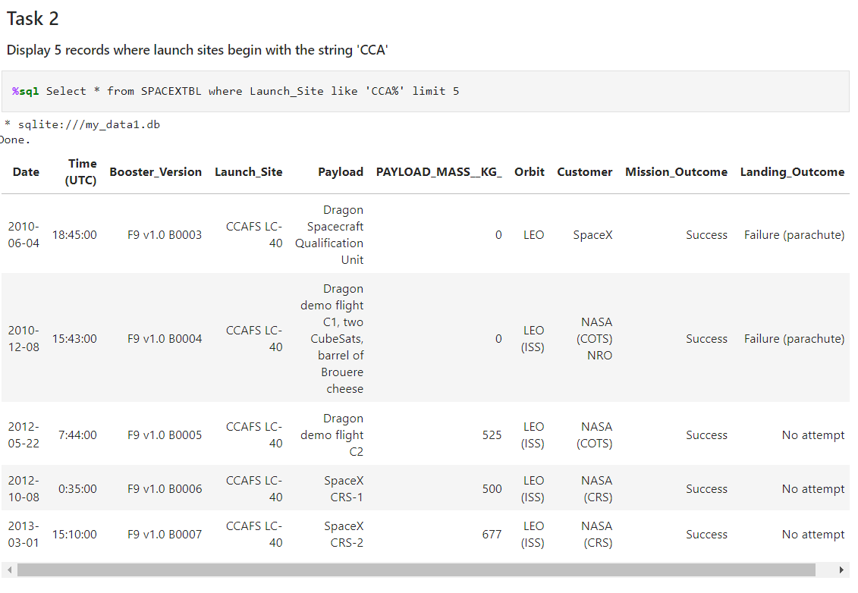
Launch Site Names Begin with 'CCA'
1) Query above shows five records from the database where launch sites begin with ‘CCA’, using a ‘where’ clause and limiting to 5 rows.

Slide 26
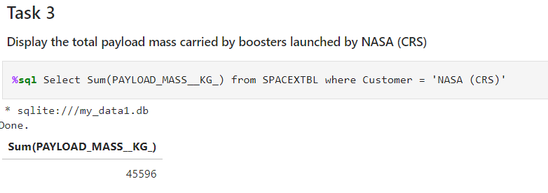
Total Payload Mass
1) Total payload mass carried by boosters launched by NASA (CRS), using a ‘where’ clause and the sum() function.

Slide 27
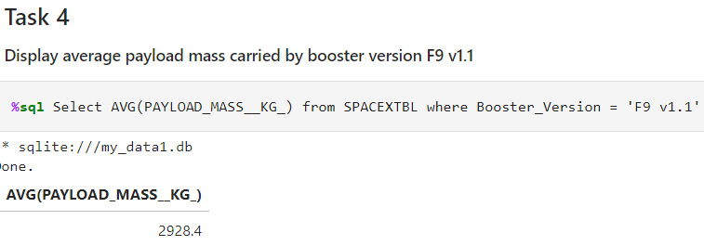
Average Payload Mass by F9 v1.1
1) Query showing the average payload mass carried by booster version F9 v1.1 via an AVG() function and ‘where’ clause.

Slide 28
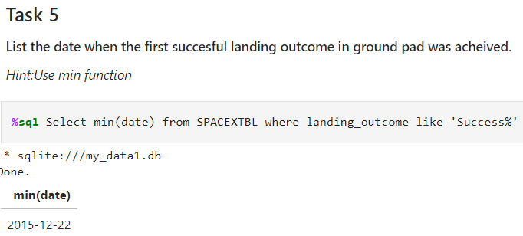
First Successful Ground Landing Date
1) Query using the min() function and a ‘where’ clause to return the date of the first successful landing outcome on the ground pad, which was 22nd December 2015.

Slide 29
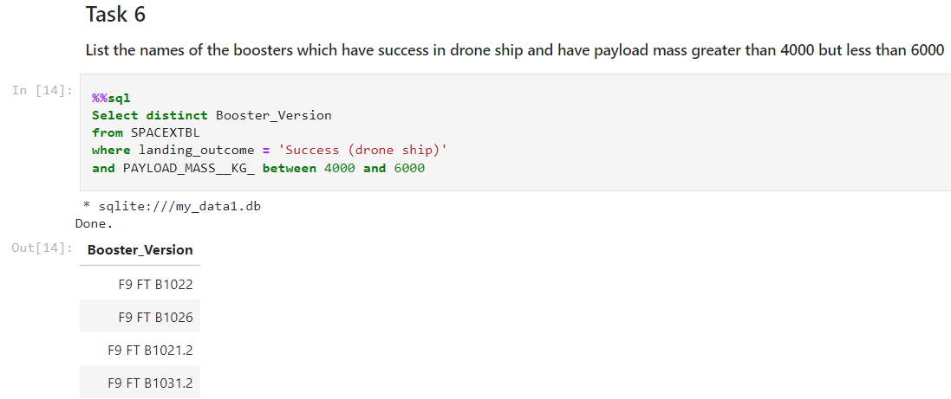
Successful Drone Ship Landing with Payload between 4000 and 6000
1) Query using a where clause to return the names of boosters which have successfully landed on the drone ship, and had a payload mass greater than 4000 but less than 6000.

Slide 30
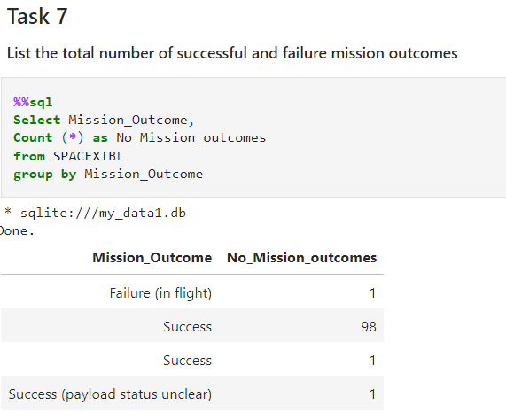
Total Number of Successful and Failure Mission Outcomes
1) Query to return the number of successful and failed missing outcomes, using a count() function and group by.

Slide 31
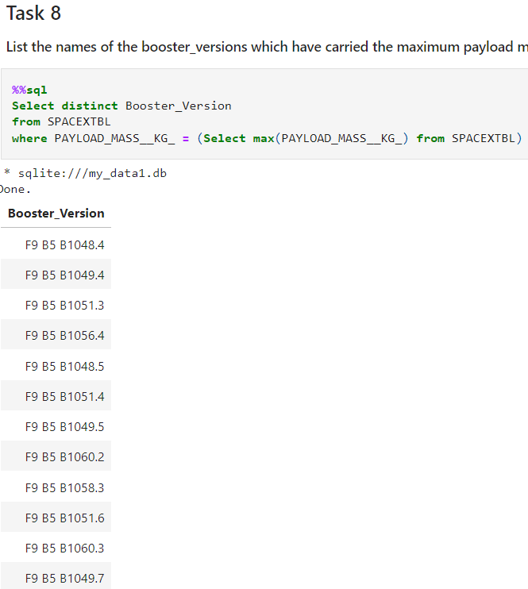
Boosters Carried Maximum Payload
1) Query returns the boosters that have carried the maximum payload using a subquery in the ‘where’ clause and the max() function.

Slide 32
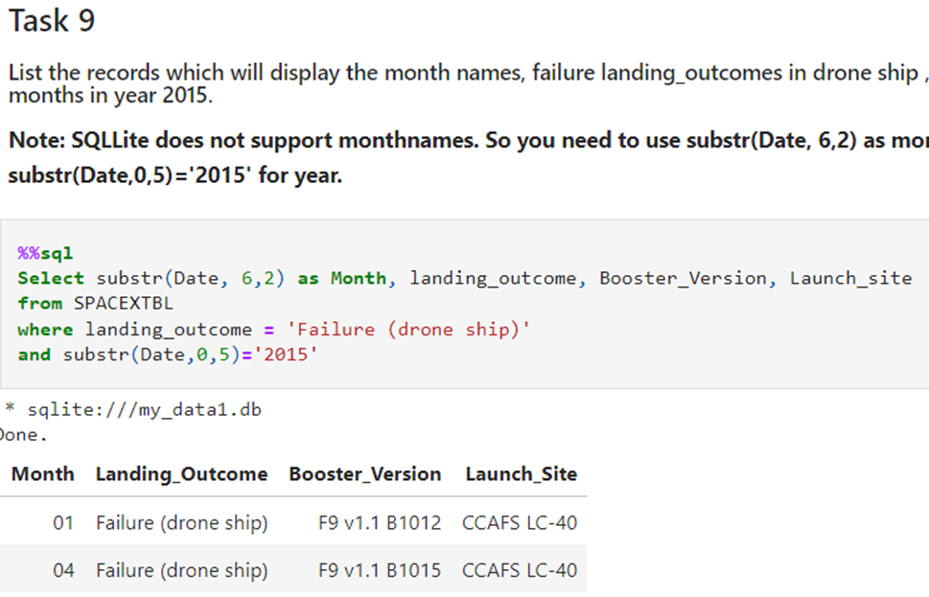
2015 Launch Records
1) List of the failed landing outcomes on the drone ship, their booster versions, and launch site names in the year 2015. Query uses substr() function and ‘where’ clause.

Slide 33
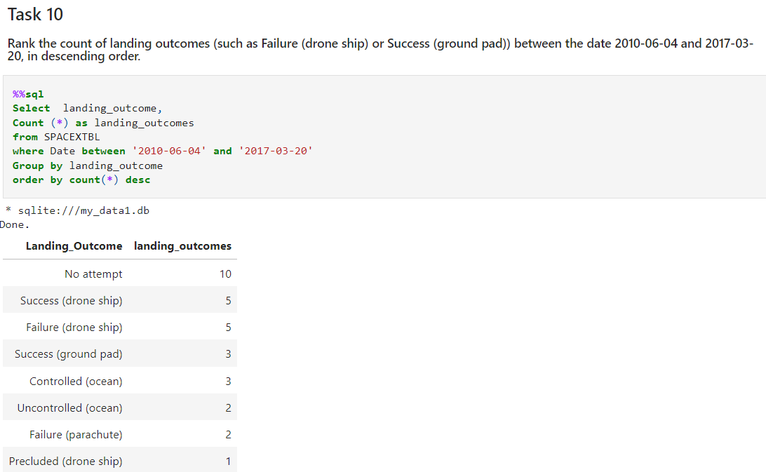
Rank Landing Outcomes Between 2010-06-04 and 2017-03-20
1) Query returns the landing outcomes in order of occurrence, between 2010-06-04 and 2017-03-20. Query uses the count() function, a group by, a ‘where’ clause, and an ‘order by’.

Slide 34

Section 3

Slide 35

Folium Map of Launch Sites
1) Adding Folium Circles and Markers for SpaceX launch sites.

Slide 36
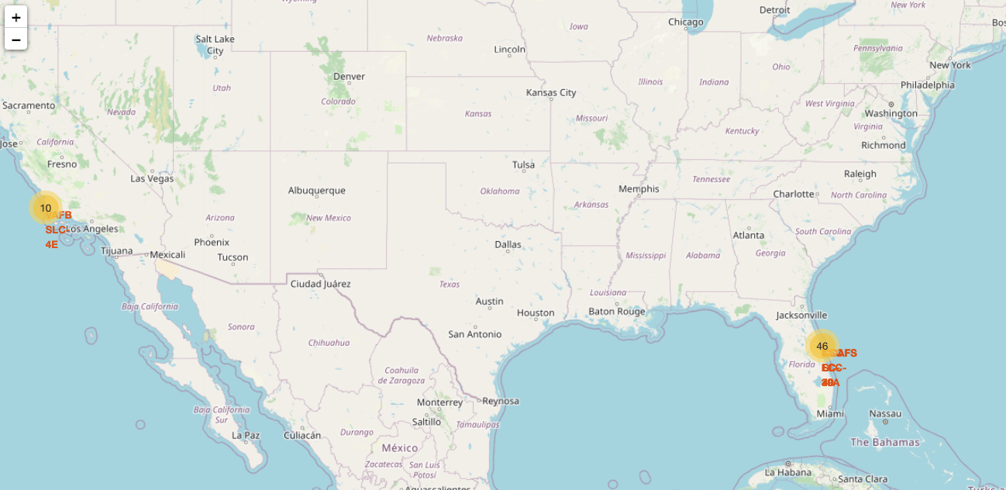

Launch Site Success using Folium Marker Clusters
1) Adding marker clusters to identify which launch sites have relatively high success rates. Green markers show successful flights, Red shows the unsuccessful flights.

Slide 37
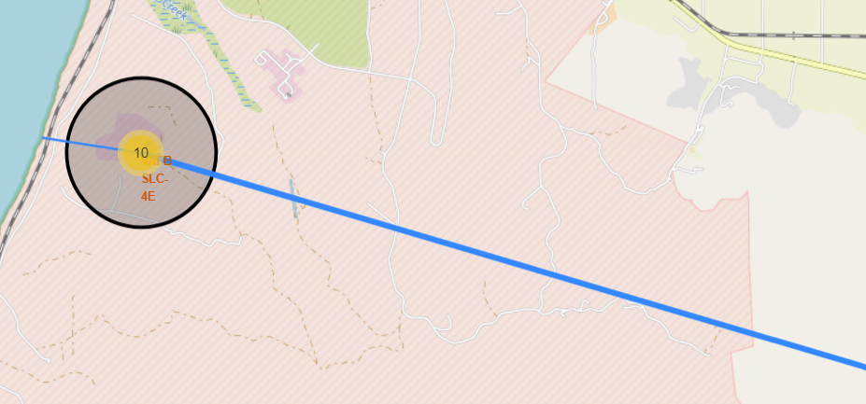
Folium Map Polyline to Local Landmarks
1) Folium Map Polyline to local landmarks, such as a nearby coastline (West) and nearby city (South East).

Slide 38

Section 4

Slide 39
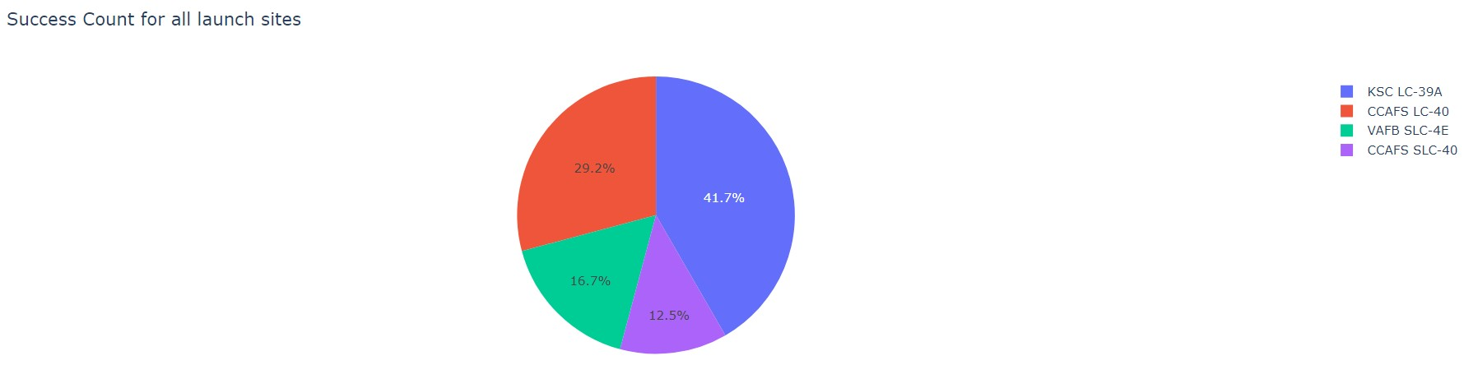
Interactive Dashboard: Launch Success Pie Chart 1
1) The Pie Chart above shows the success count for all the launch sites. It is evident that launch site KSC LC-39A was the most successful with 41.7% of the total successful flights.

Slide 40
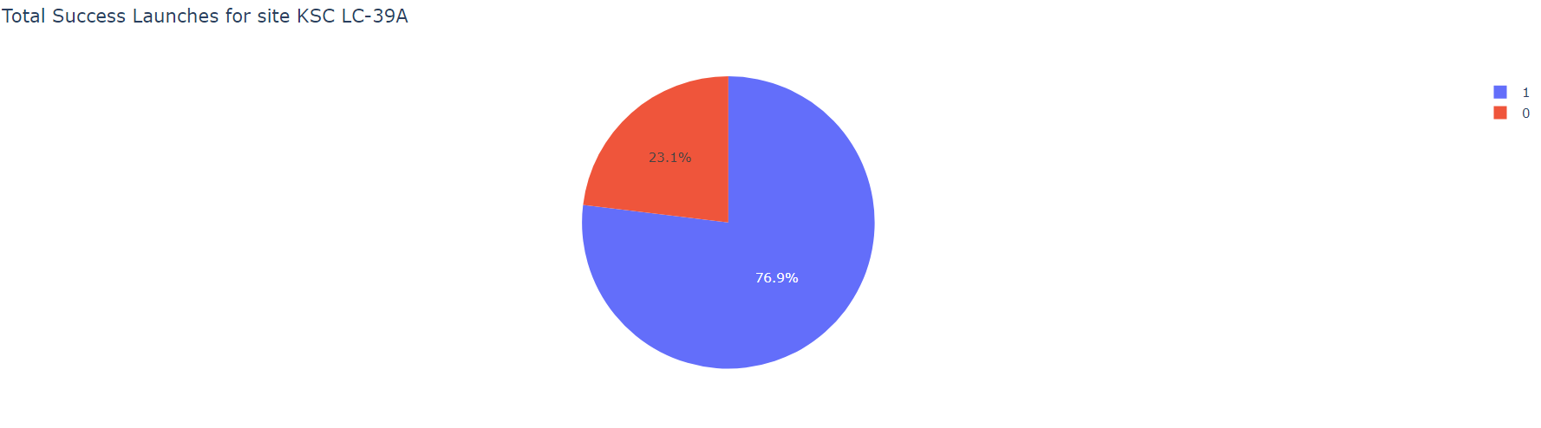
Interactive Dashboard: Launch Success Pie Chart 2
1) The Pie Chart above is filtered onto the most successful launch site KSC LC-39A. We can see that 76.9% of the flights from this launch site were successful.

Slide 41
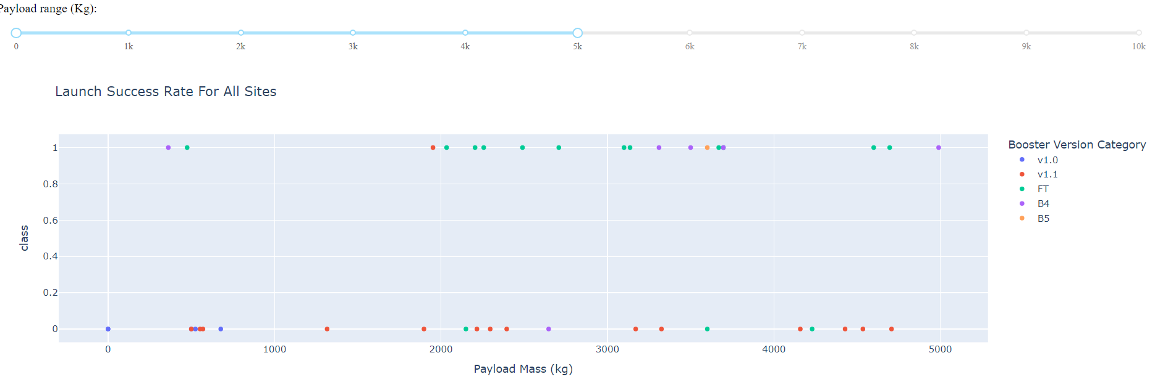
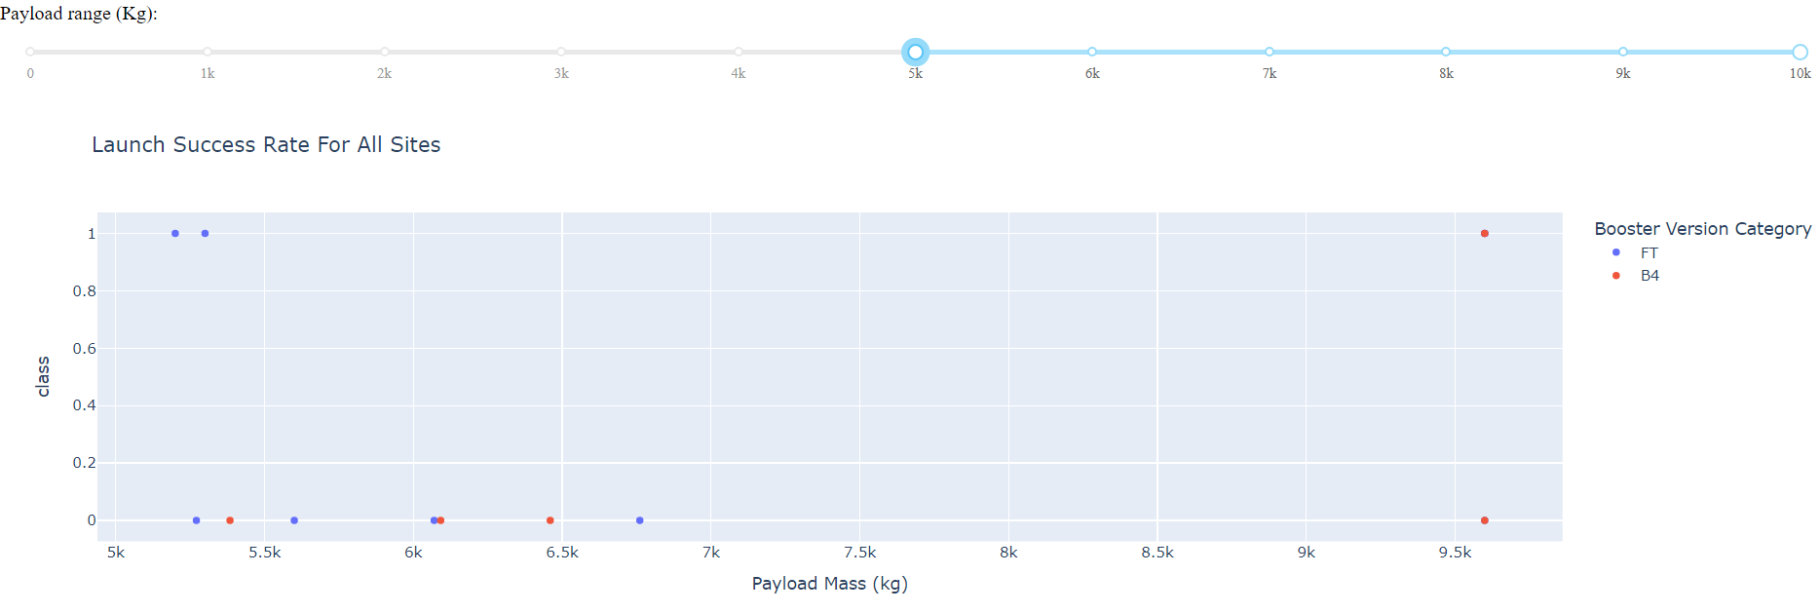
Interactive Dashboard: Payload vs Launch Outcome
1) Using the filters on the Scatter Plots above, we can see that payloads < 5000kg had more success than the payloads > 5000kg. However, payloads < 5000kg were more frequent.

Slide 42

Section 5

Slide 43
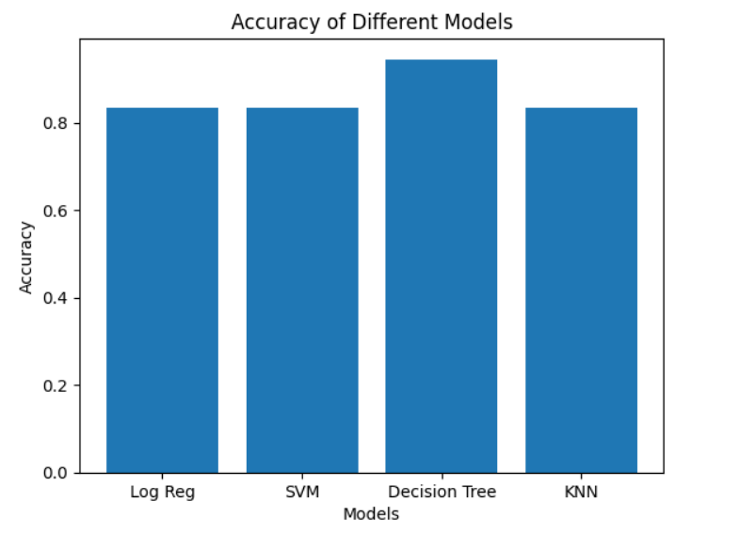
Classification Accuracy
1) Using MatPlotLib we can see that the Decision Tree method had the highest accuracy of roughly 0.9 and is therefore the best performing.

Slide 44
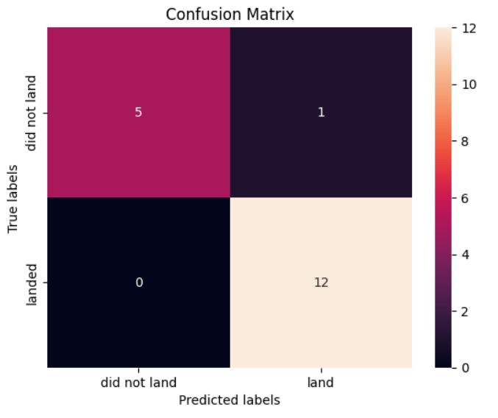
Confusion Matrix
1) The Confusion Matrix for the Decision Tree method shows that it only produced 1 false positive and no false negatives.

Slide 45
Conclusions
Machine Learning can be used to predict the success of a SpaceX Falcon9 Rocket flight.
The Decision Tree Method proved to be the most accurate, at roughly 90% accuracy.
Flight success has increased between the years 2013 and 2020, showing that space travel is getting closer to saving money through reusable rockets.
Orbit reached has shown to have a key relationship with flight success, with orbits ES-L1, GEO, HEO, and SSO having 100% success rate.
Launch site also has demonstrated a key relationship with flight success with launch site KSC LC-39A having the most successful launches of any site.

Slide 46
Appendix
GitHub repository: https://github.com/andrewdoublard/IBM-Capstone
• SpaceX API: https://api.spacexdata.com/v4/launches/past
• Falcon9 and Falcon Heavy Wikipedia page: https://en.wikipedia.org/wiki/List_of_Falcon_9_and_Falcon_Heavy_launches

Slide 47


